Slide 1
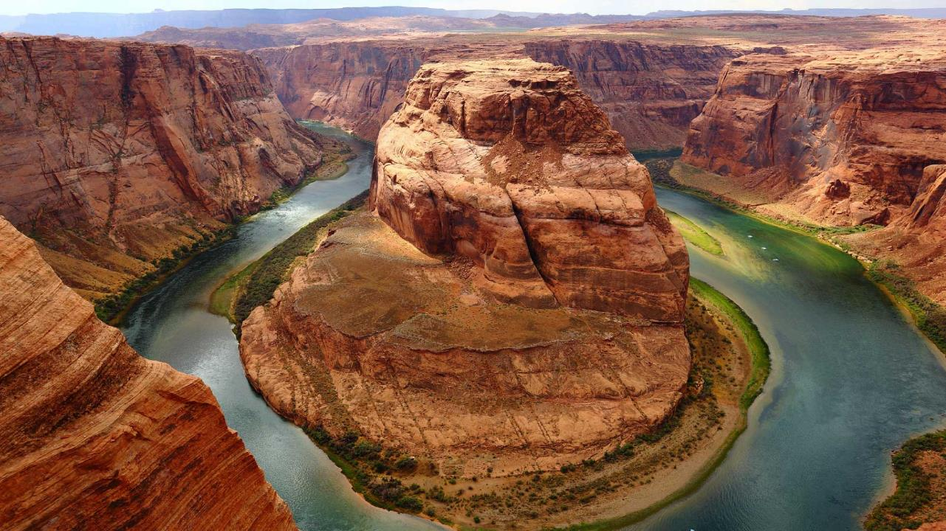
Tour++
N
W
E
S
Your Fantastic Partner On the Way
Notes:
A template for students to design a field trip to a location for other students to view. Includes directions to the student of what to include on each slide and what content should be considered.

Slide 2
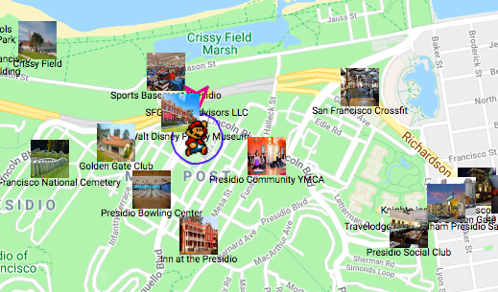
Tour++
Tour++ is a web-based APP that provides self-triggered audio guide for points of interests according to use’s GPS locations in real time while travelling.

Slide 3
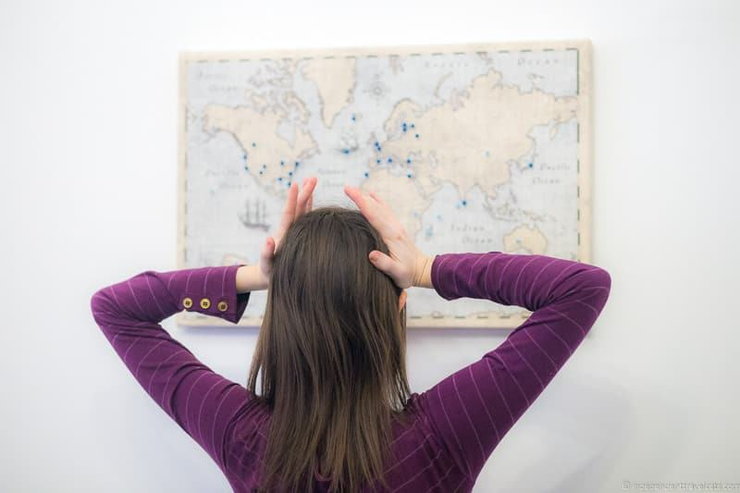
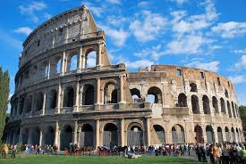

Inspiration:
Everyone one wants a meaningful trip
Notes:
In the light of Tourism growing faster then ever, every single tourist desires for a meaningful and relaxing trips after a long period of hardworking and studying.
To have a meaningful trips, 99% will choose either to hire a tour guide or conduct an extensive research for the place they are visiting.
Quality of tour guides varies and hugely depends on the experience which is hard to measure
After being aware of it, we targets to develop an mobile application to release millions of tourists from extensive pre-hand research and extra cost for hire a tour guide

Slide 4
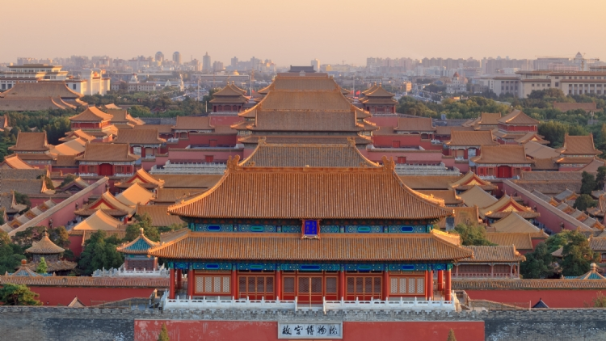
My Story
The Forbidden City

Slide 5





My Story
The Forbidden City

Slide 6
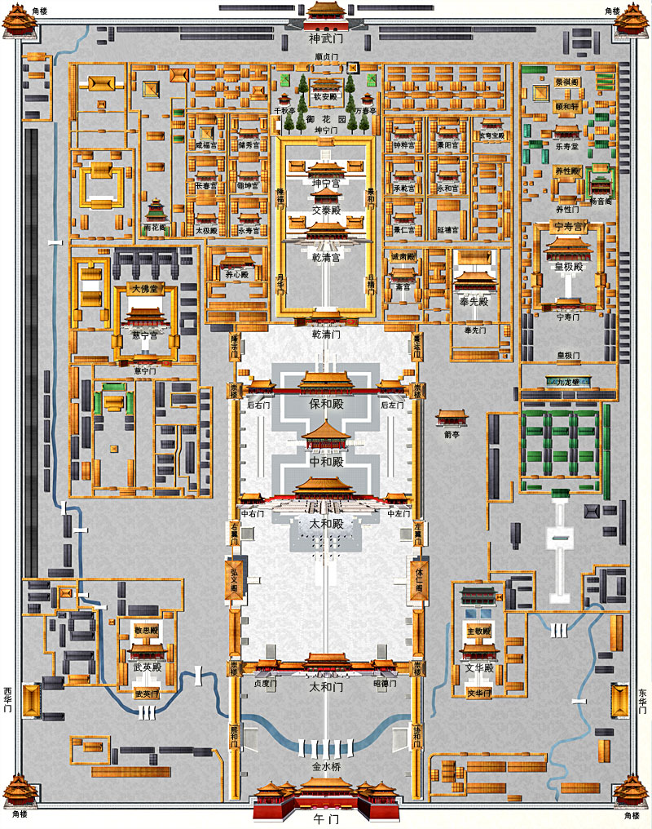
My Story
The Forbidden City
Huge but compact
Easy to miss points of interest
Tons of historic facts/fun stories
Human tour guides run short

Slide 7
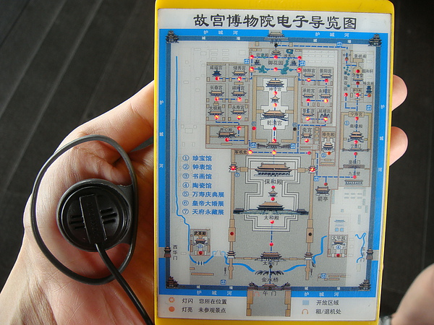
My Story
The Forbidden City
Electronic audio guide
Location based
Easy to use
Can we extend the idea to the outside world
No need to take phones out for site information constantly while traveling

Slide 8
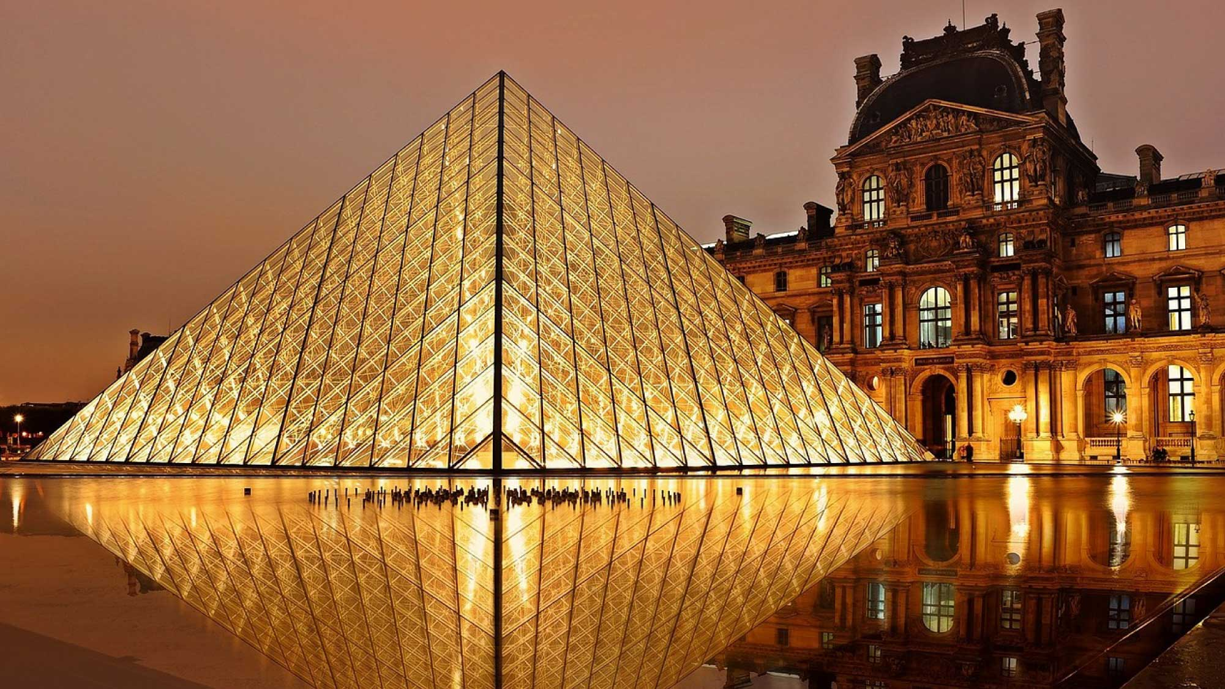
Tour++
Self-triggered audio tour guide.
Help locating the POI.
Tour planning.
Visual + Audio = Pure Joy
Notes:
For example, Astoria Oregon is a town on the Oregon coast well know for its starring role in the movie “The Goonies”. Today, we will take a trip from our school to Astoria through miles and time…

Slide 9
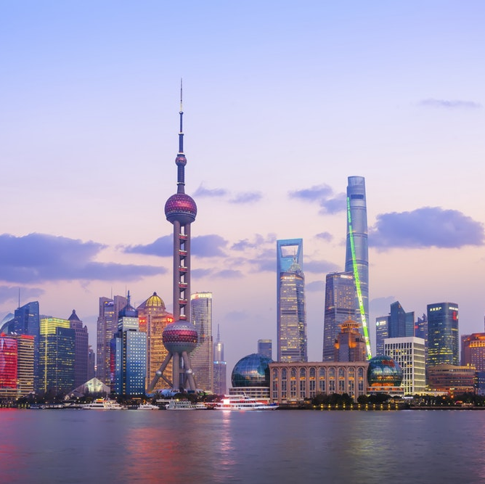
Social Impacts
About 38 million overseas U.S. Travelers in 2017.
About 1034 billion dollars spent on traveling in 2017 worldwide.
Tour++:
Enhance travel experience for everyone.
Visually impaired people can benefit.

Slide 10

Technologies:
Google Cloud API (Map, Place)
Wikipedia API
ResponseVoice Text-to-Speech API
Node.js backend
Pure HTML, CSS, JavaScript frontend

Slide 11
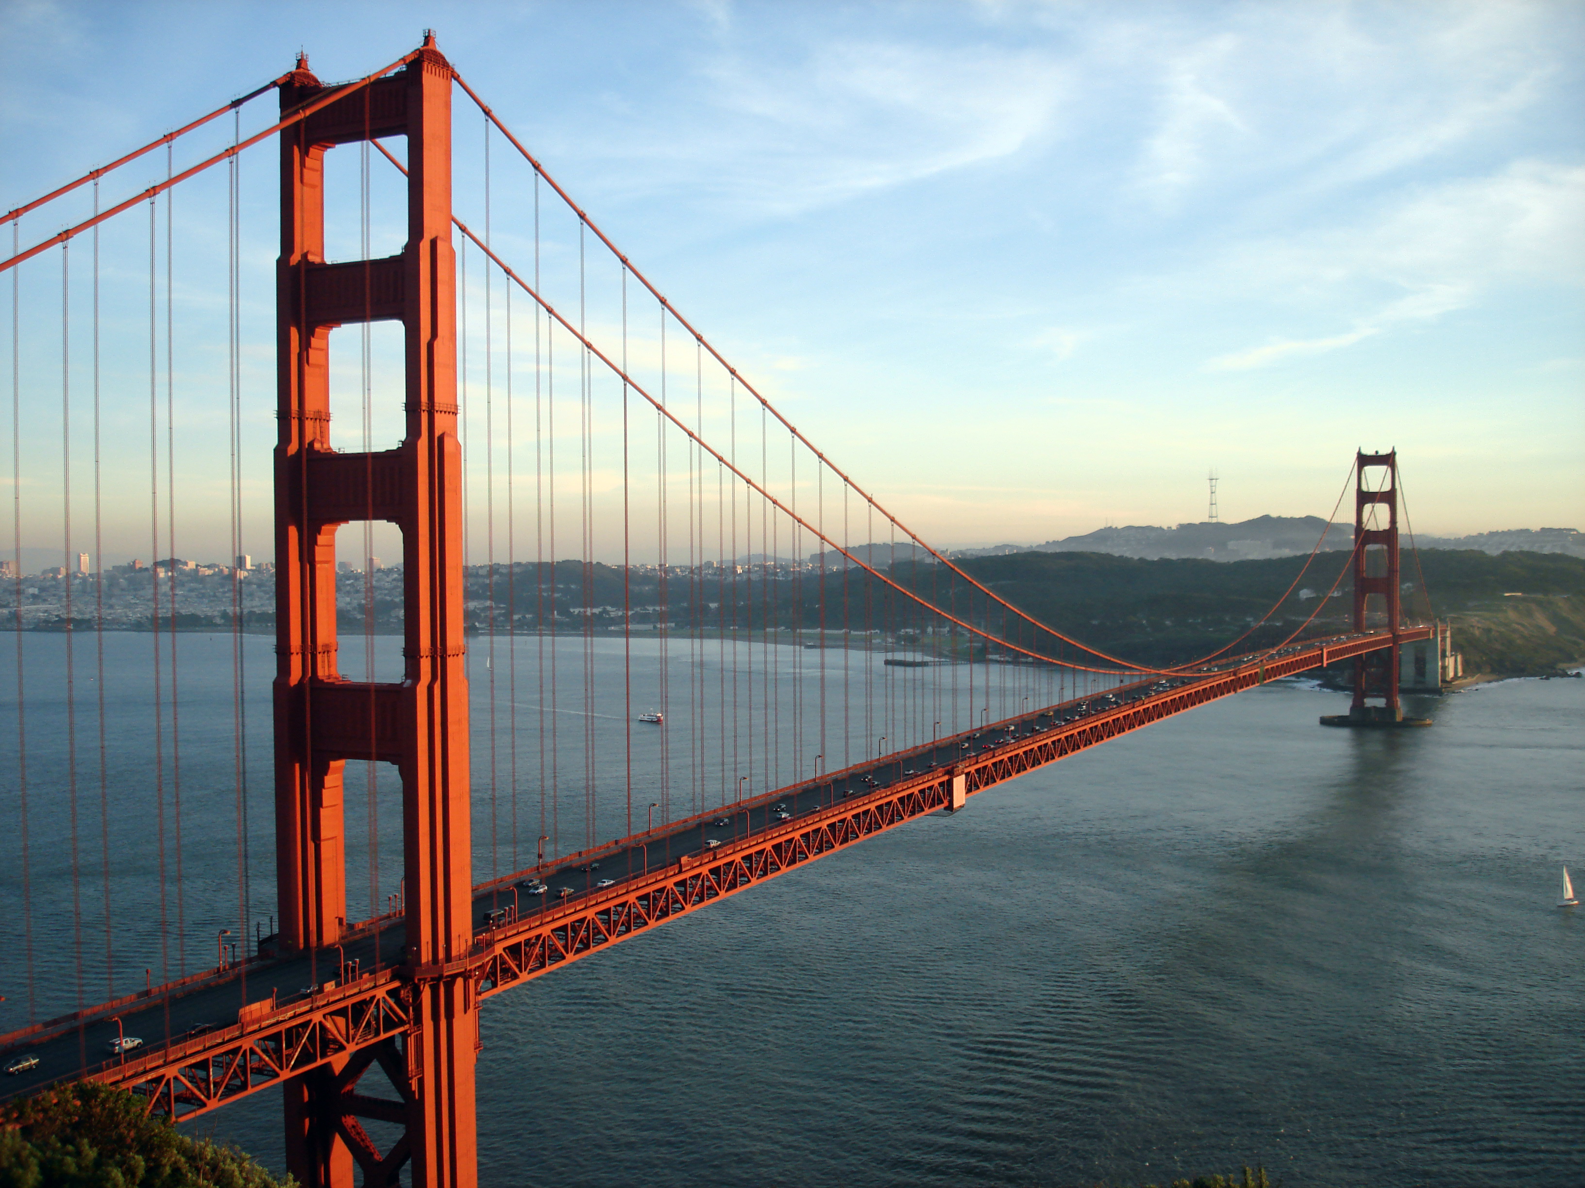

Wish you all travel like
SUPER MARIO

Slide 12
Reference
US Travel Association: https://www.ustravel.org/answersheet

